Slide 1
NAAN MUDHALVAN
SALESFORCE PROJECT REPORT
PROJECT TITLE: CRM APPLICATION THAT HELPS TO BOOK A VISA SLOT
COLLEGE: PONJESLY COLLEGE OF ENGINEERING
BATCH-7
NAME | NM ID | REG NO
ASWIN .D.S | 8B0E216605B65B6CE45B09F5D68556D46AD | 961820114025

Slide 2
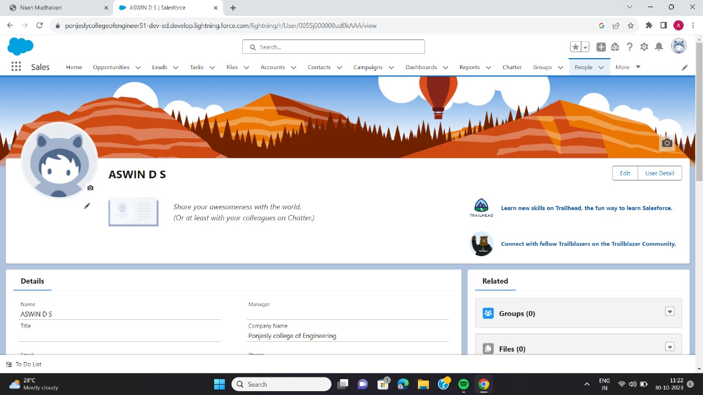
Step 1: Create Salesforce account

Slide 3
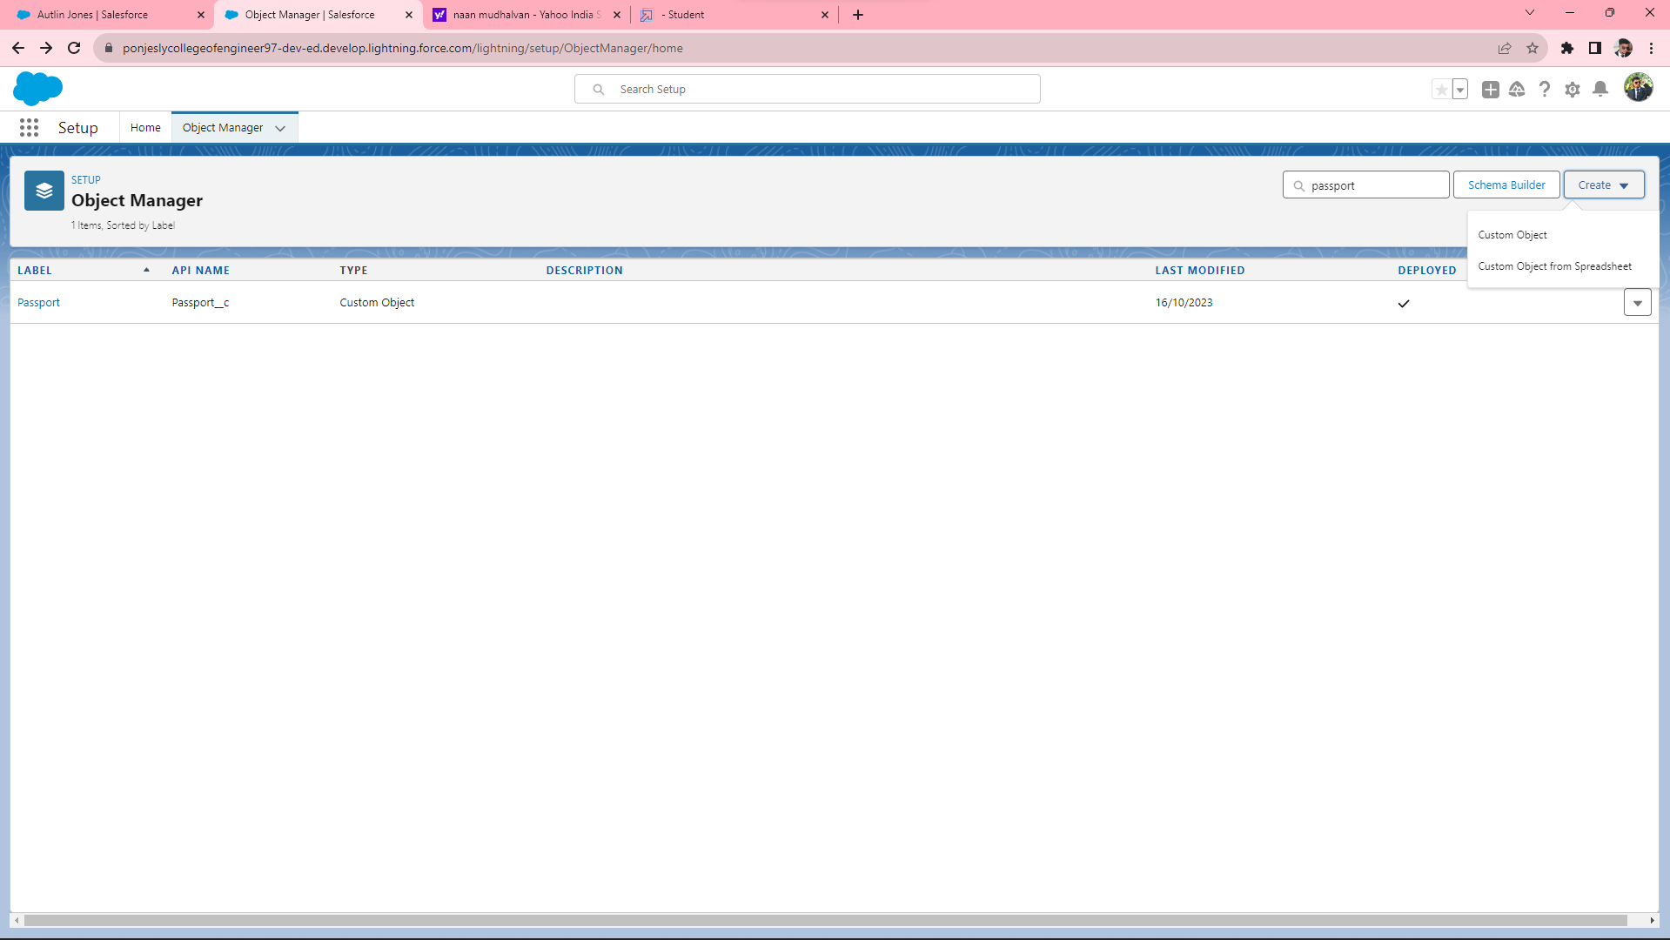
Step 2: Create the Object (Passport, Visa Slot, Payment)

Slide 4
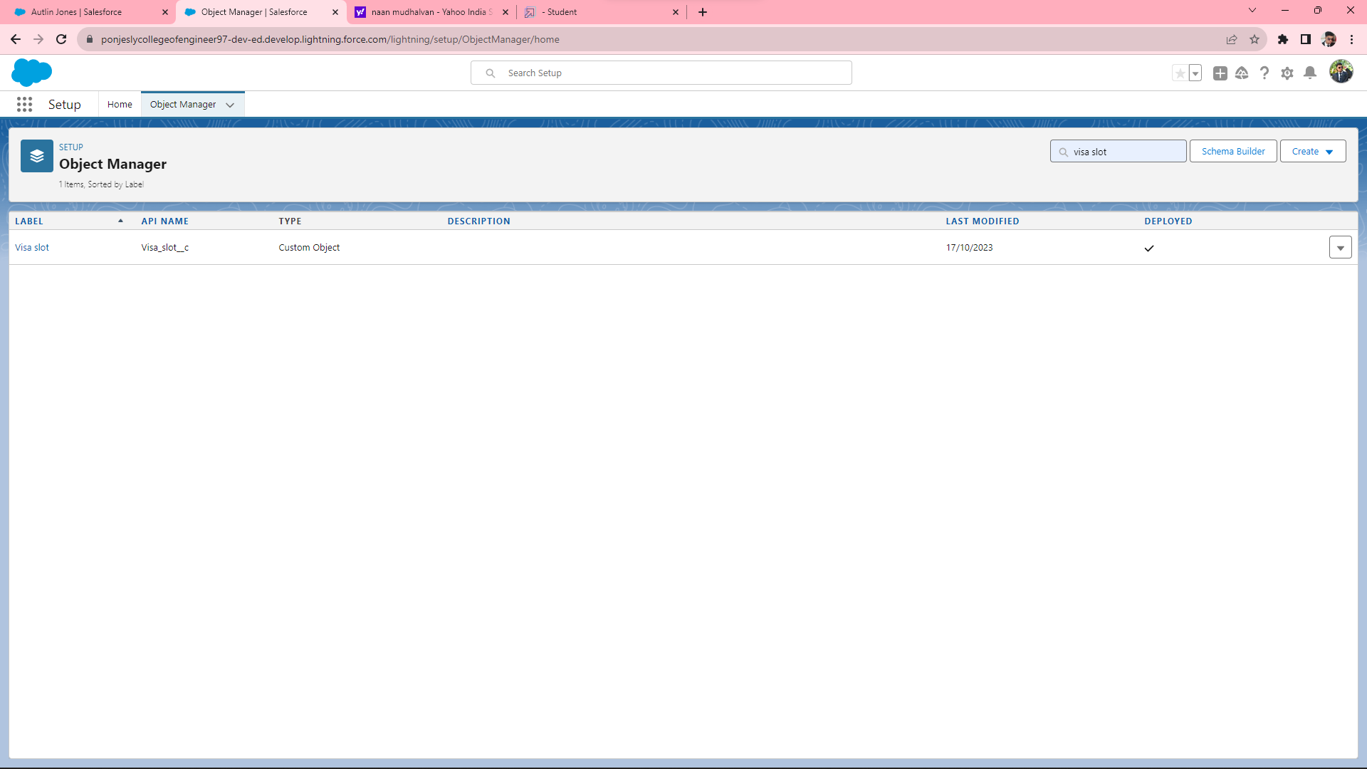

Slide 5
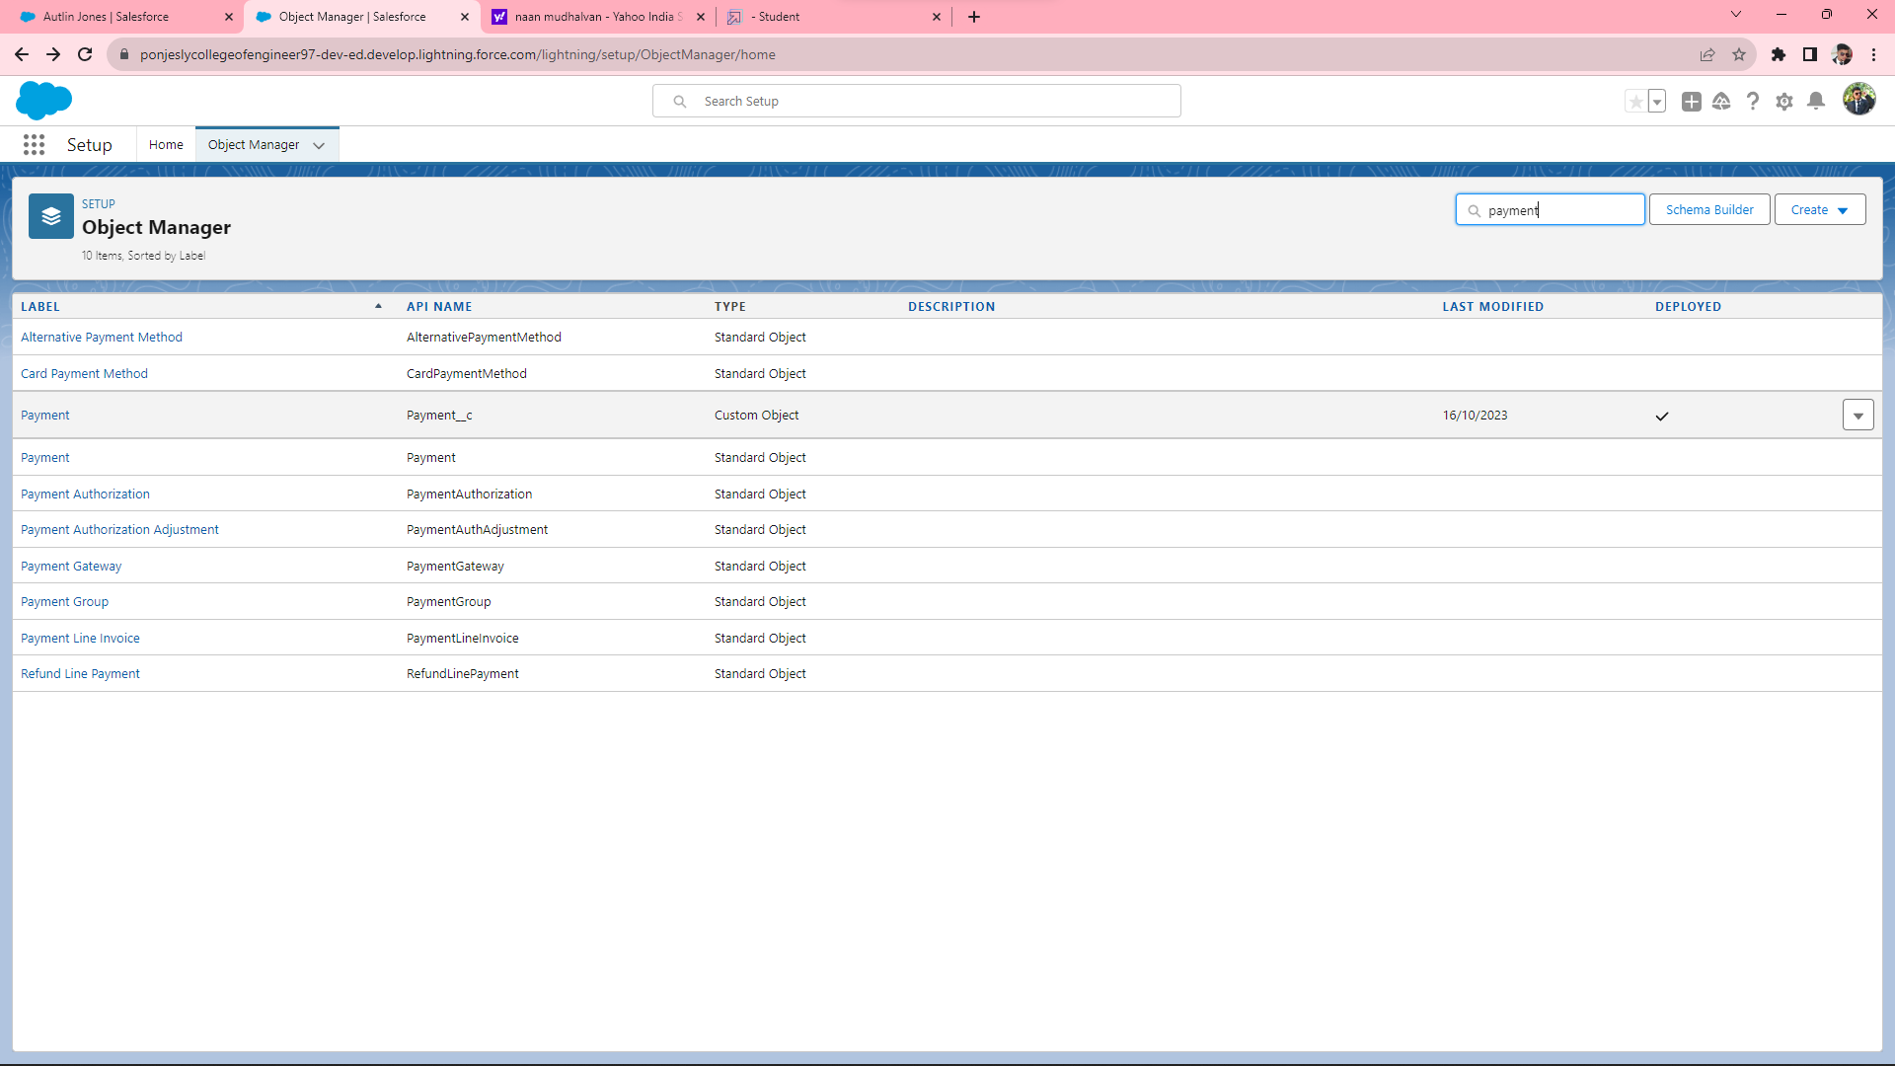

Slide 6
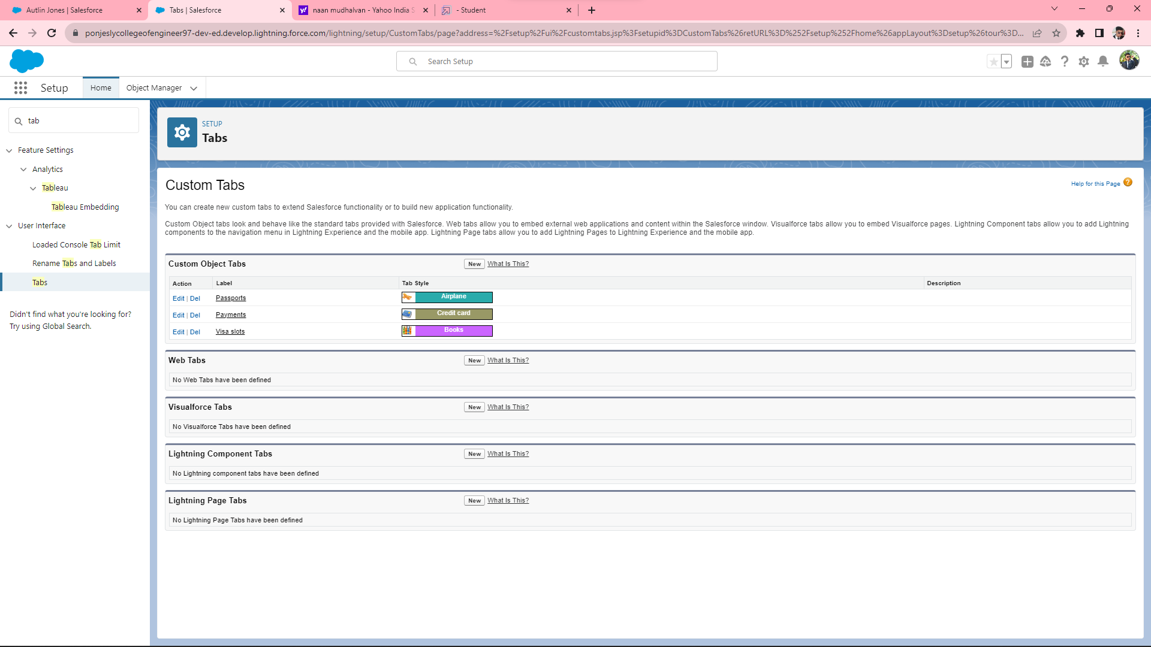
Step 3: Create the Tab (Passport, Visa Slot, Payment)

Slide 7
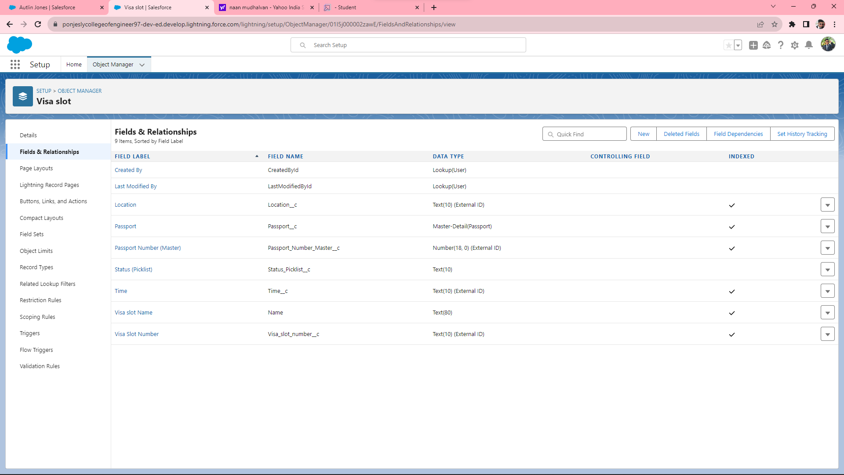
Step 4: Create the Relationship B/W Object

Slide 8
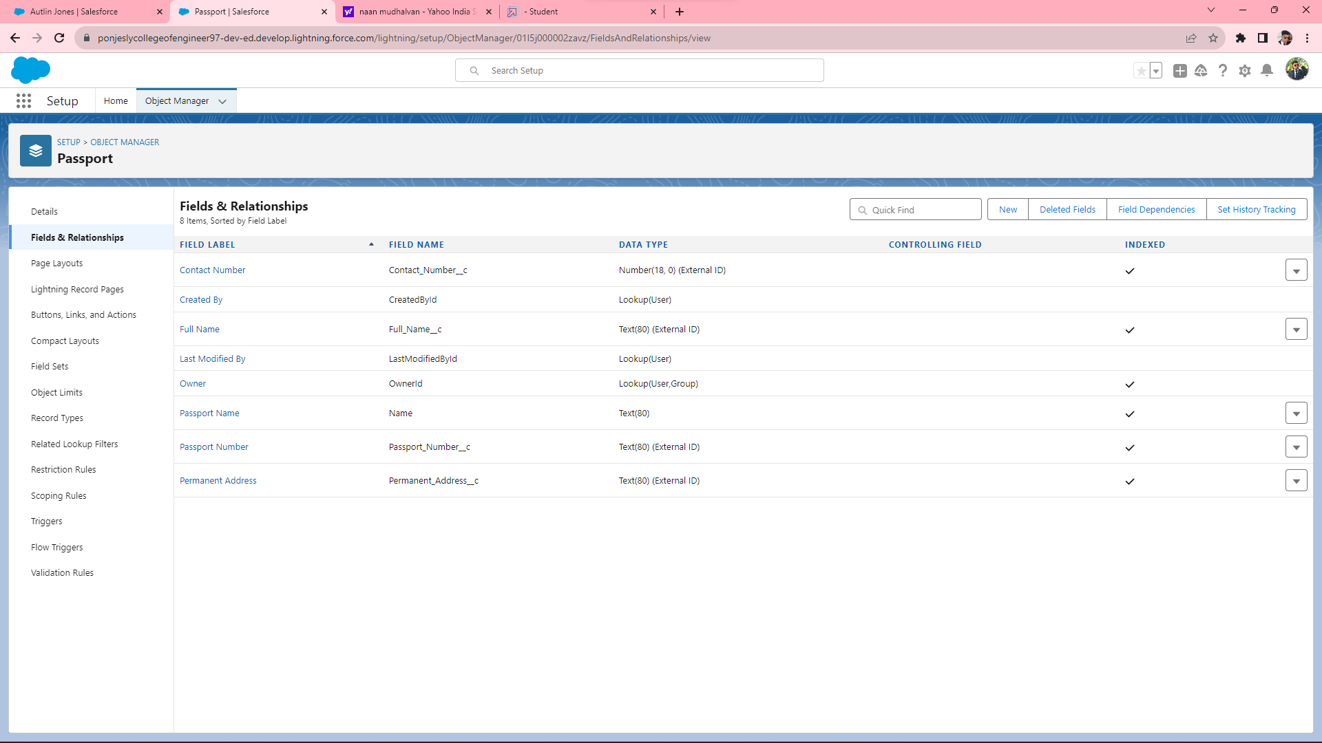
Step 5: Create the Fields for Respective Object(Passport, Visa Slot, Payment)

Slide 9


Slide 10
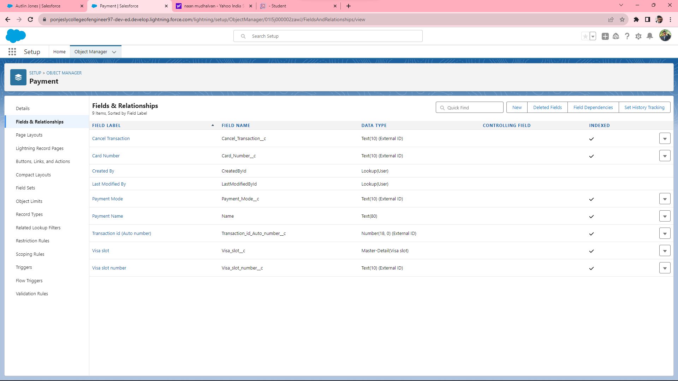

Slide 11
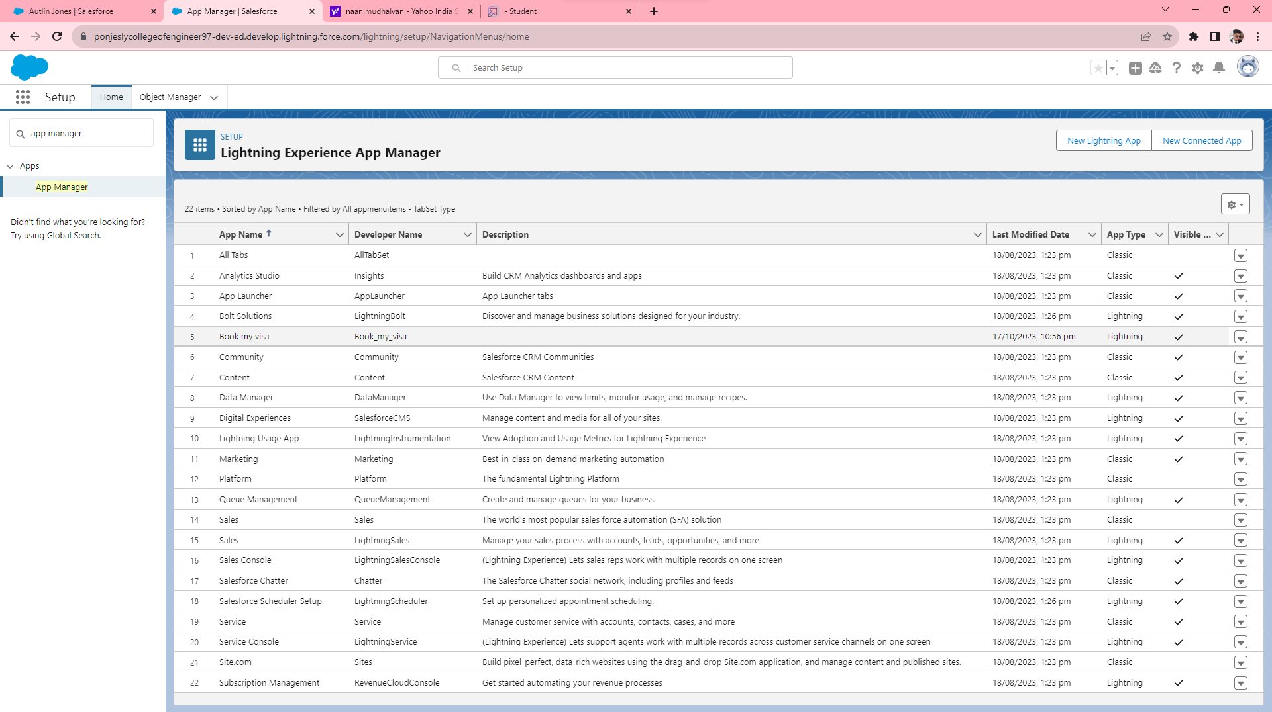
Step 6: Create an App

Slide 12
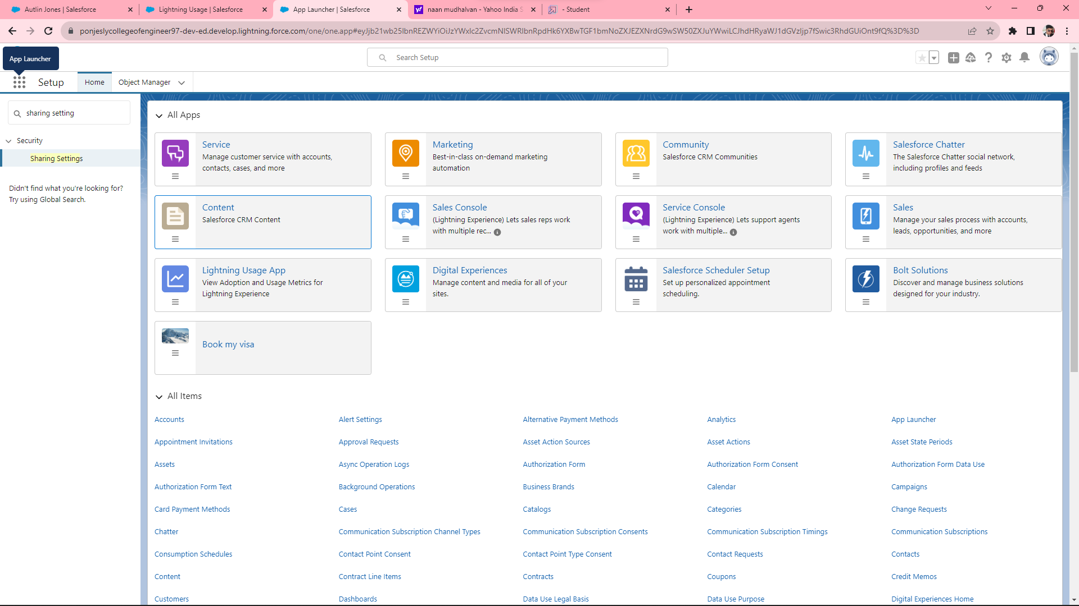

Slide 13
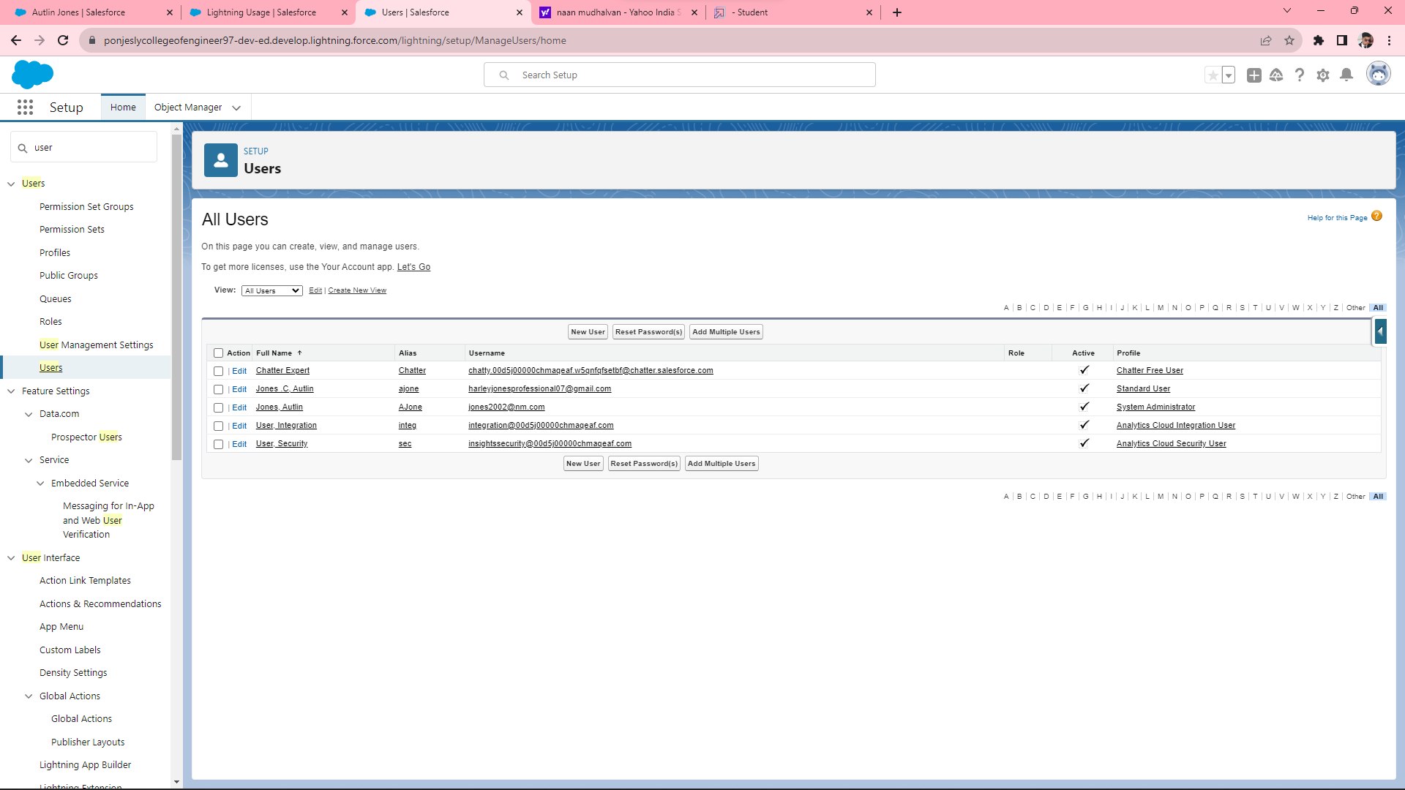
Step 7: Create an User & OWD Organisation default setting.

Slide 14
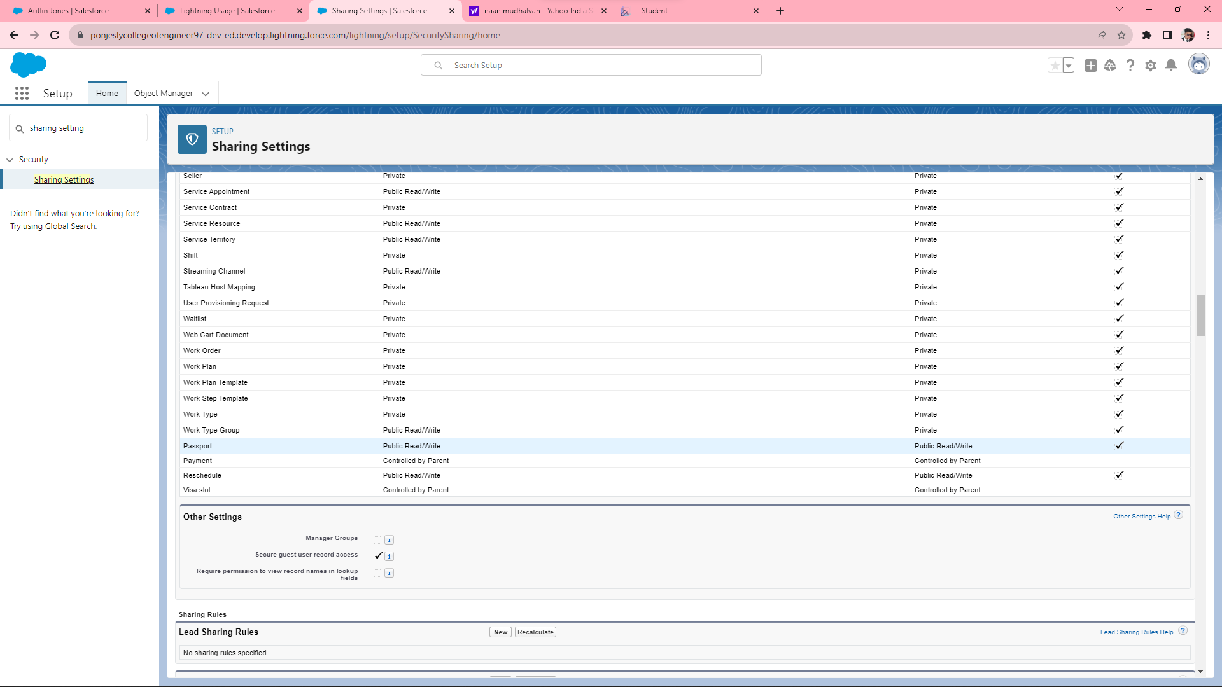

Slide 15
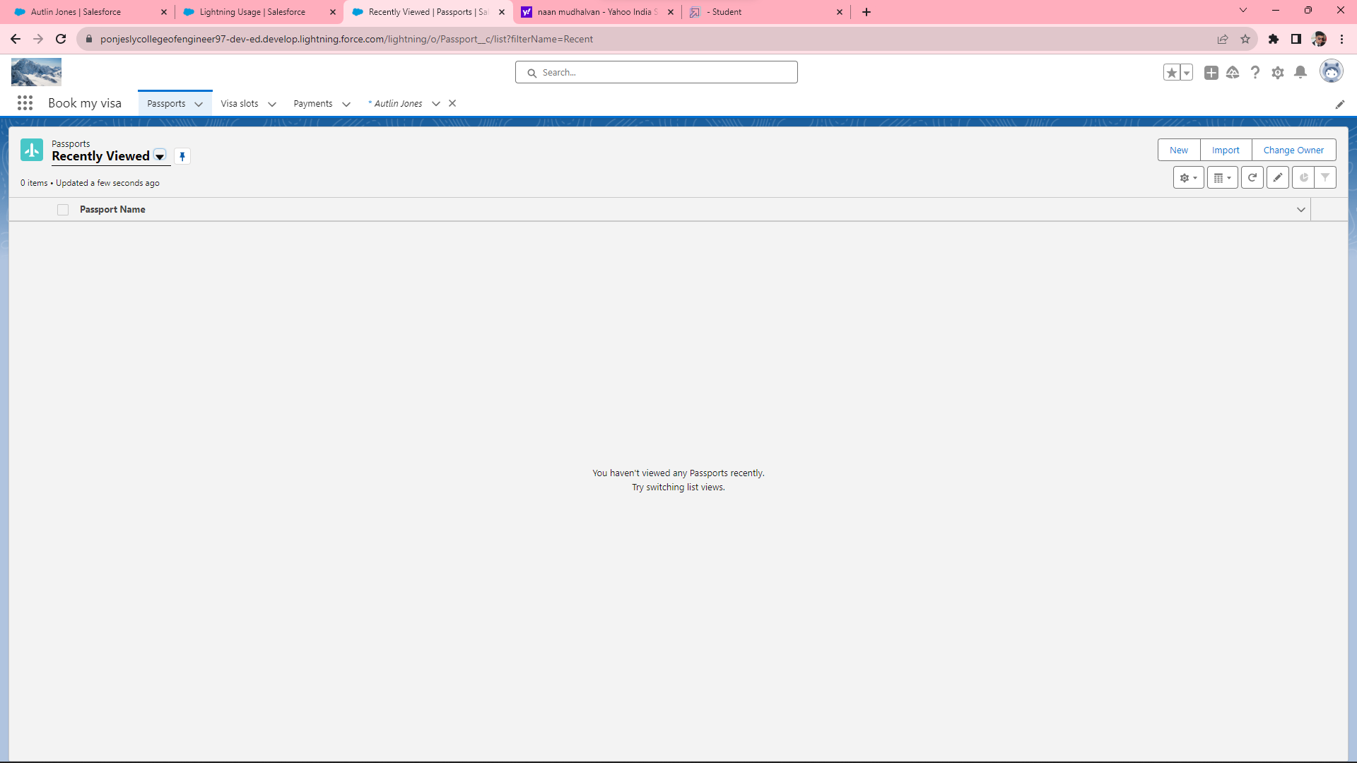
Step 8: User Adoption (create, view, delete records of Passport)

Slide 16
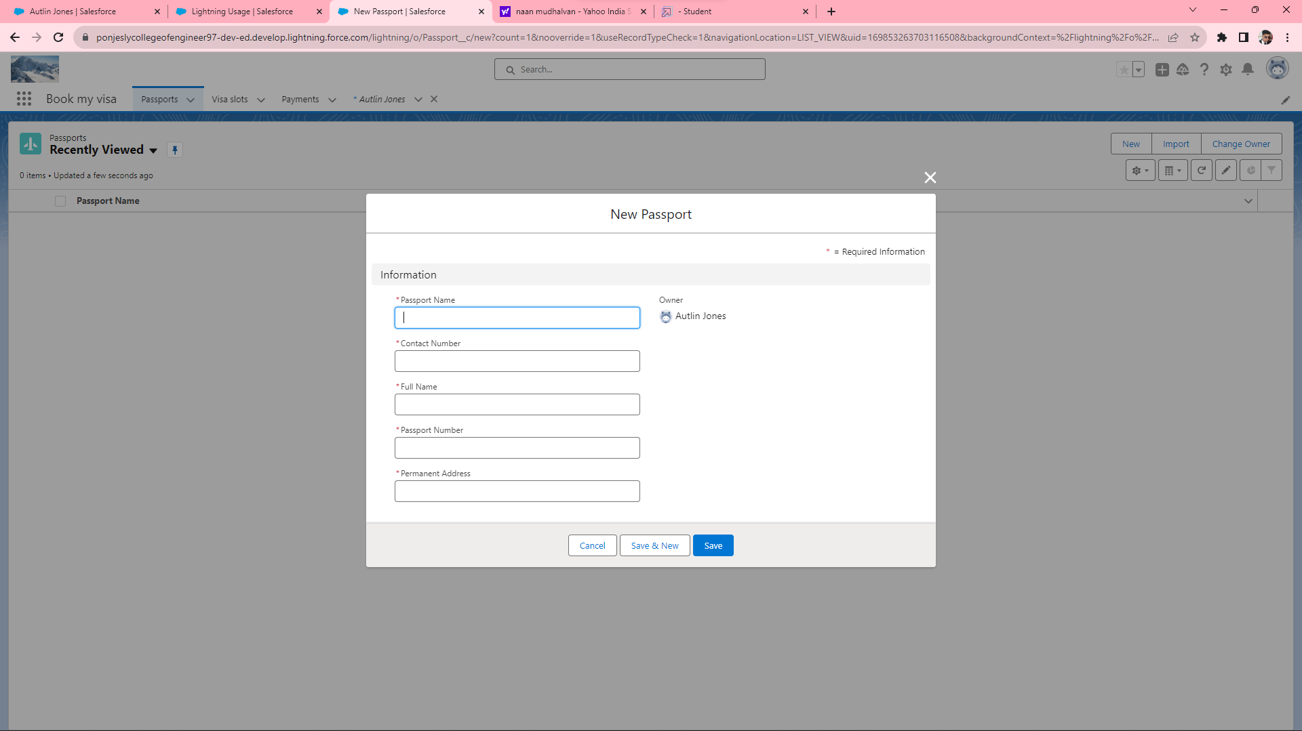

Slide 17
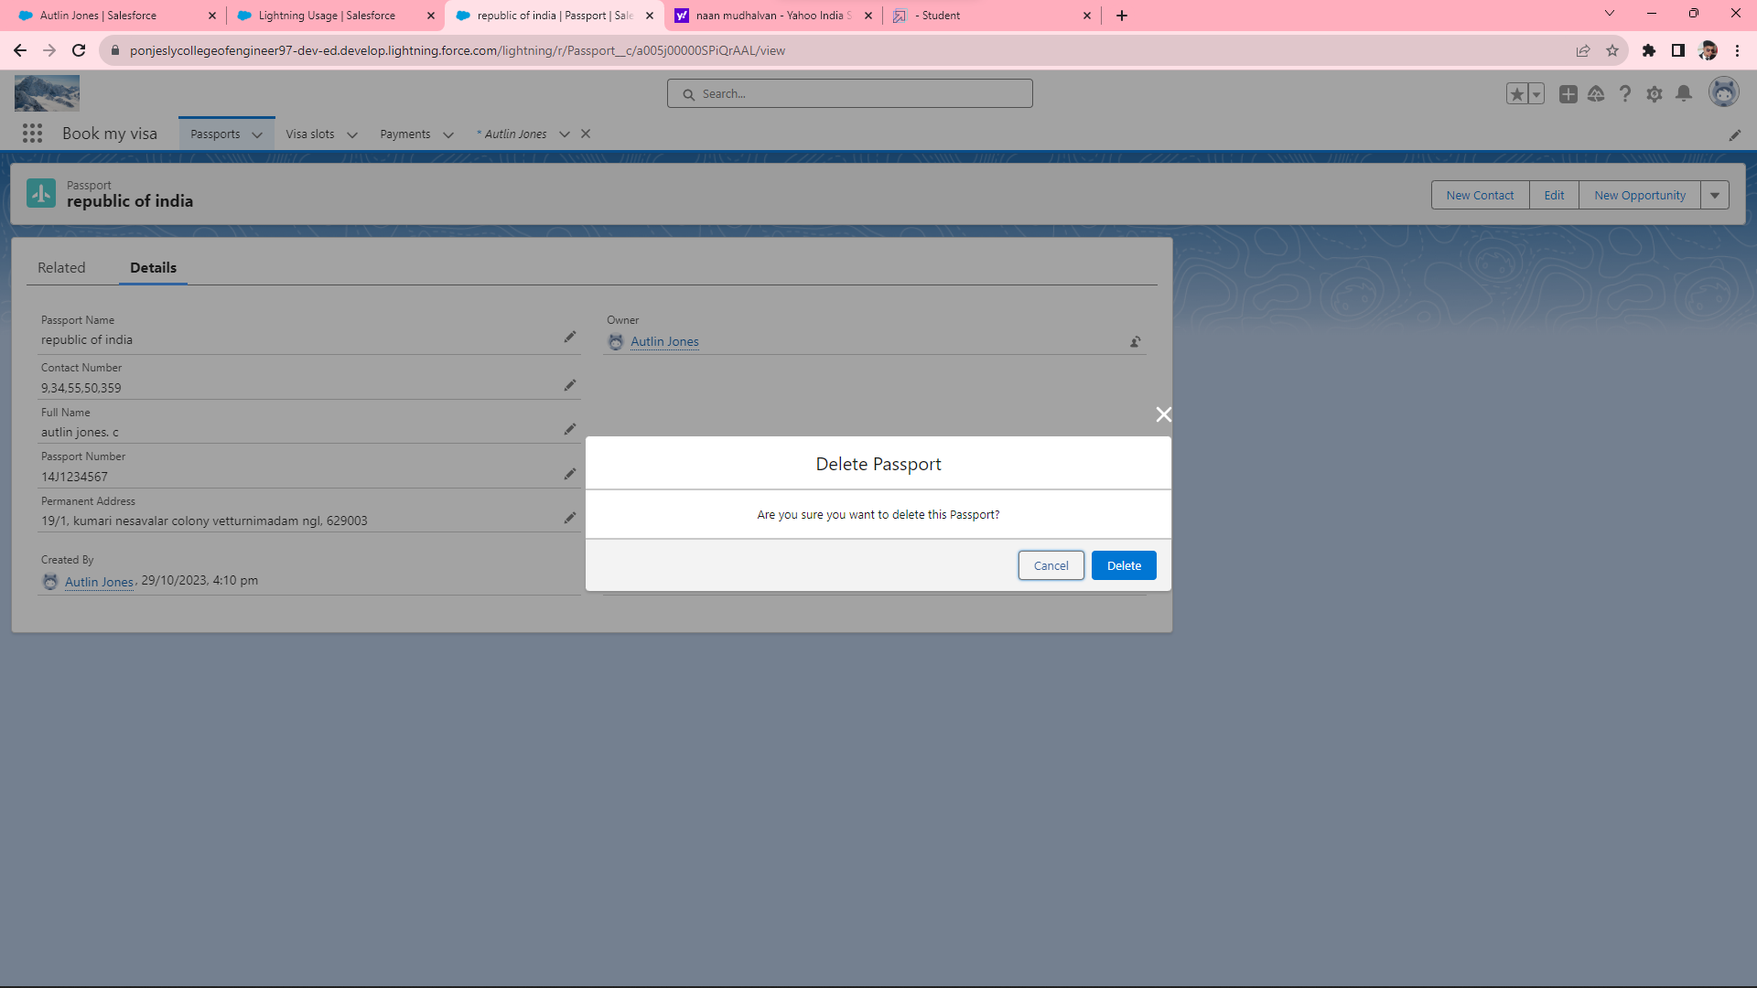

Slide 18
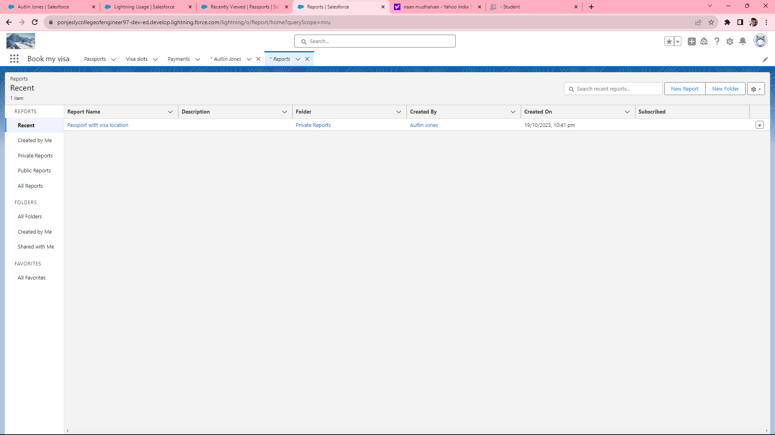
Step 9: Create & View a Report.

Slide 19
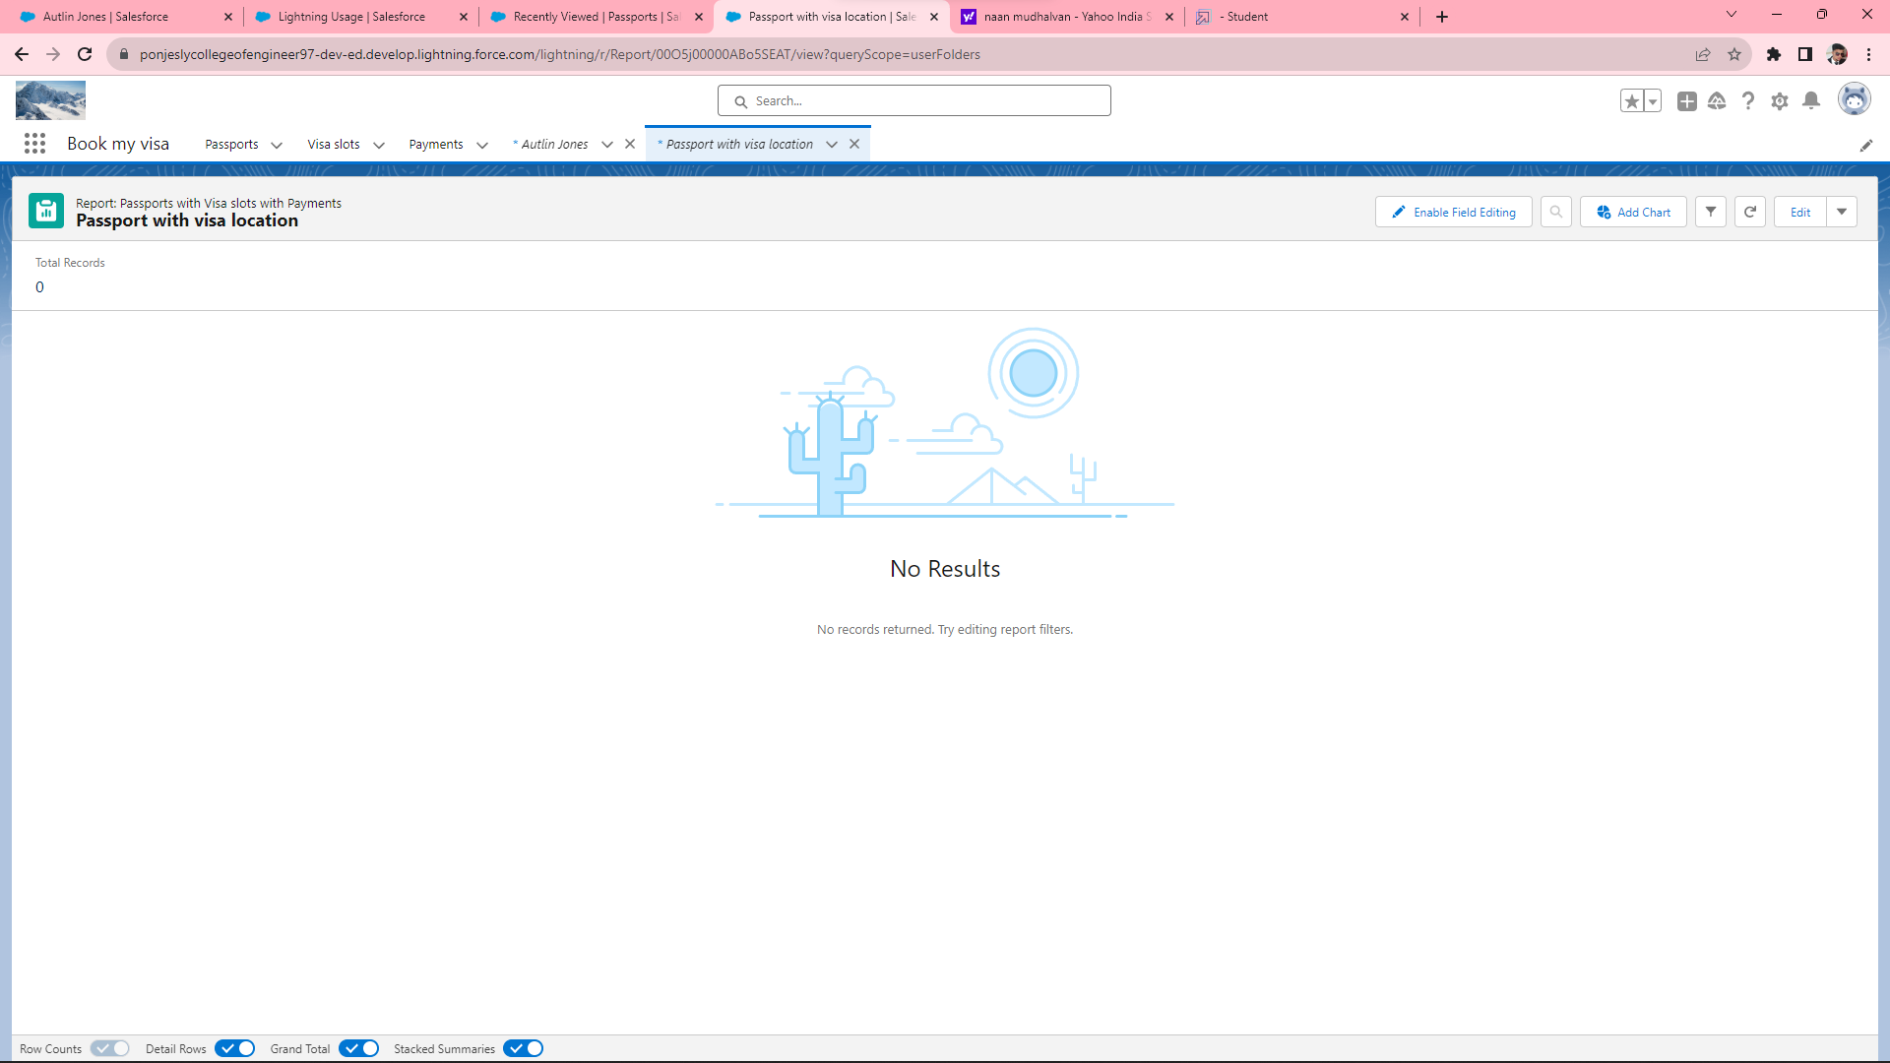

Slide 20
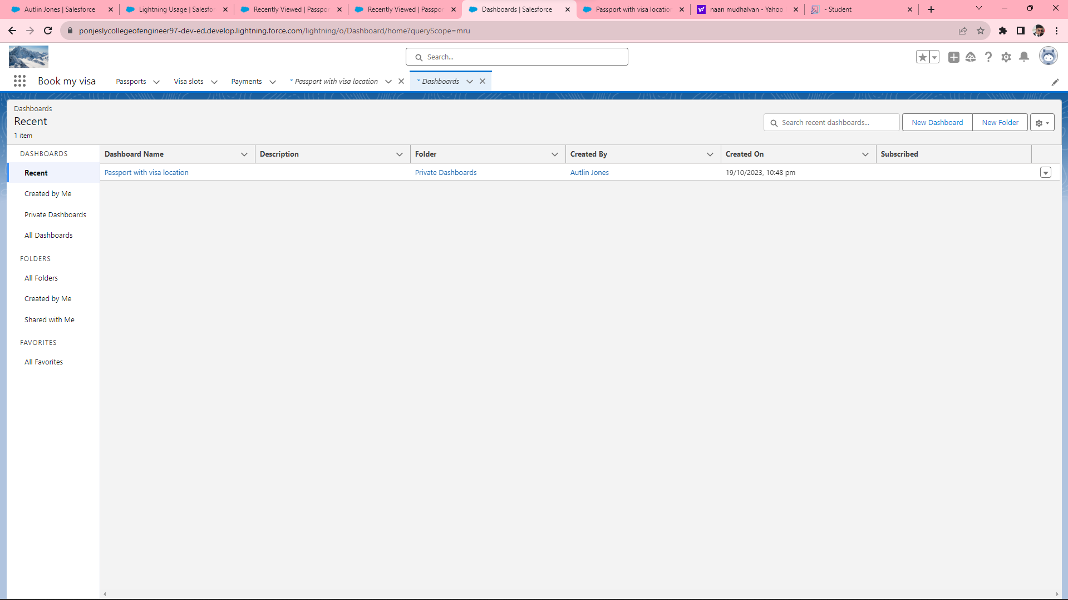
Step 10: Create & View a Dashboard.

Slide 21
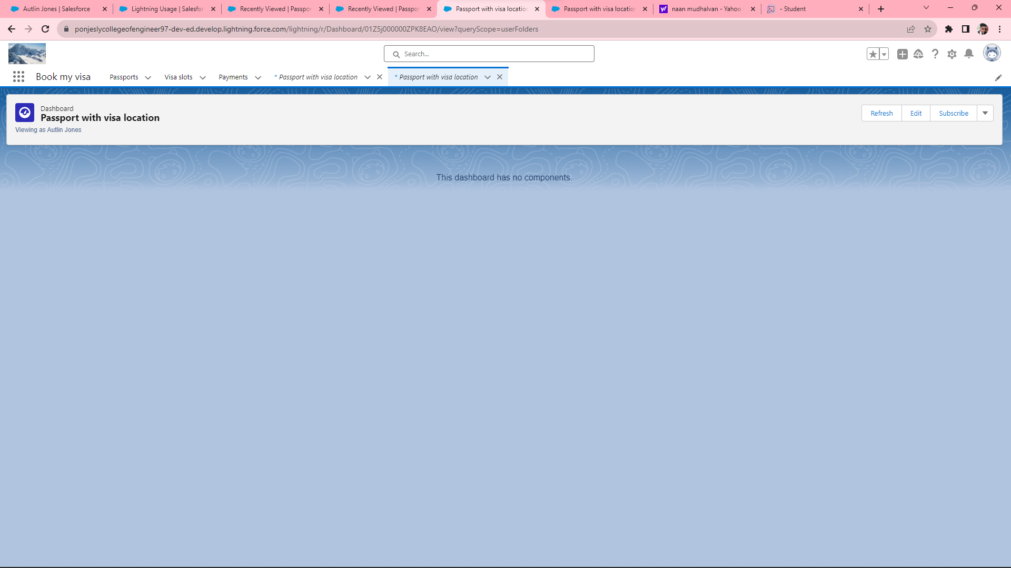

Slide 22
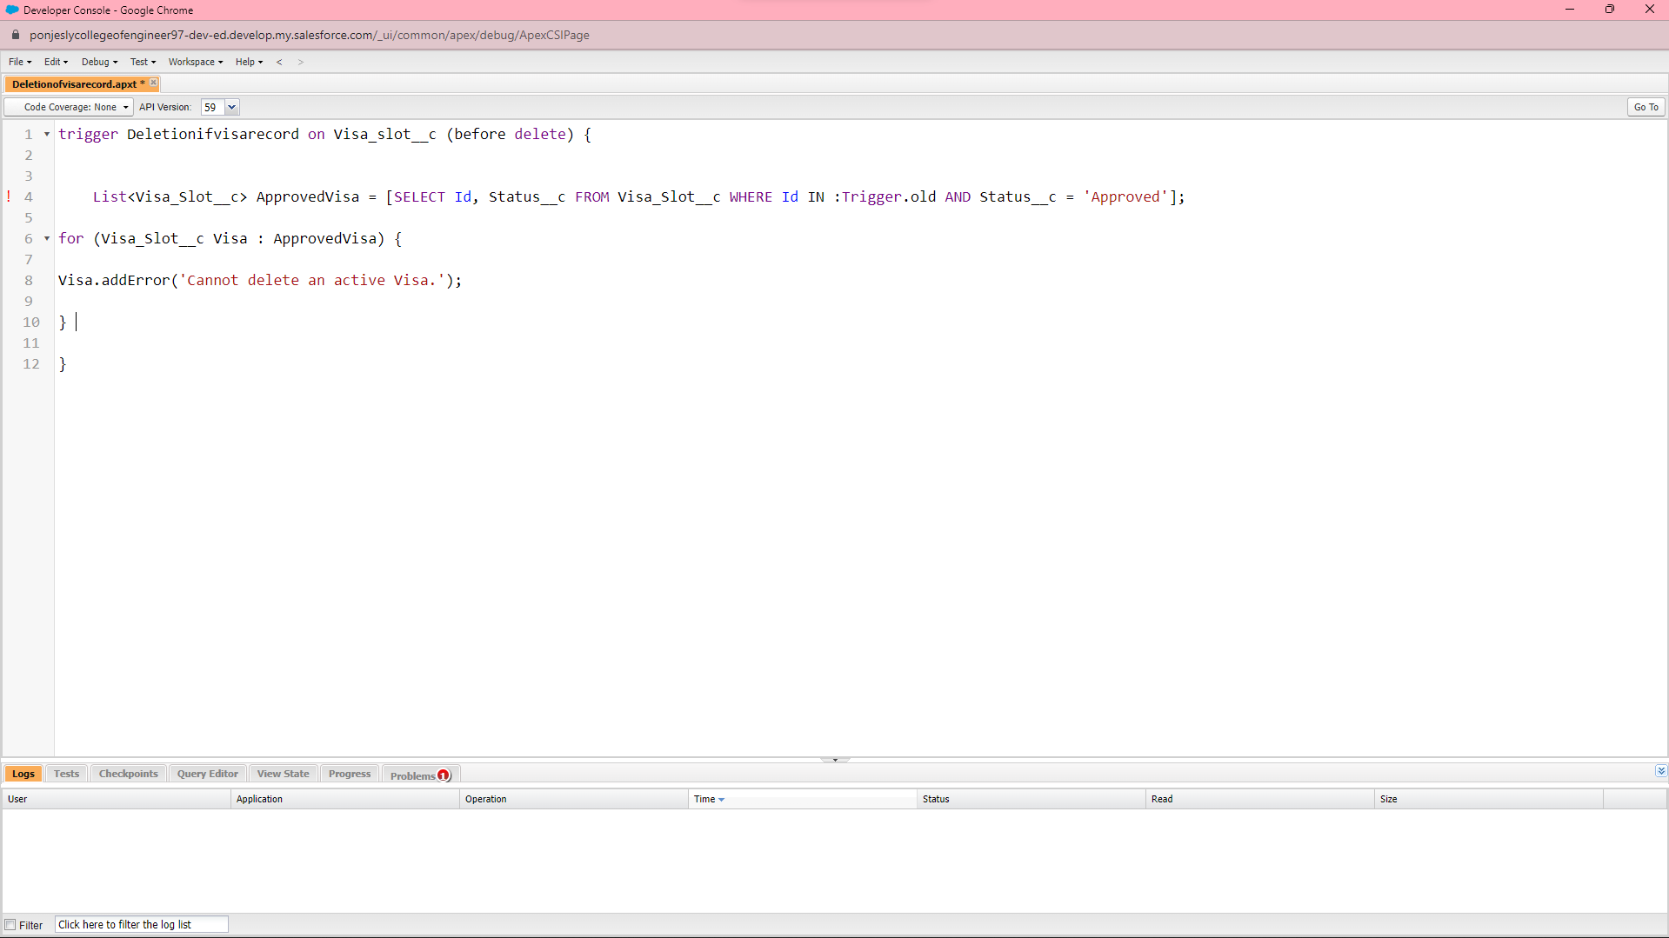
Step 11: Create an Apex Trigger.

Slide 23
